Slide 1
Growth Models

Slide 2
Agenda
Start | End | Item
 |  | Gompertz Curves
 |  | Bass Models
 |  | SIR

Slide 3
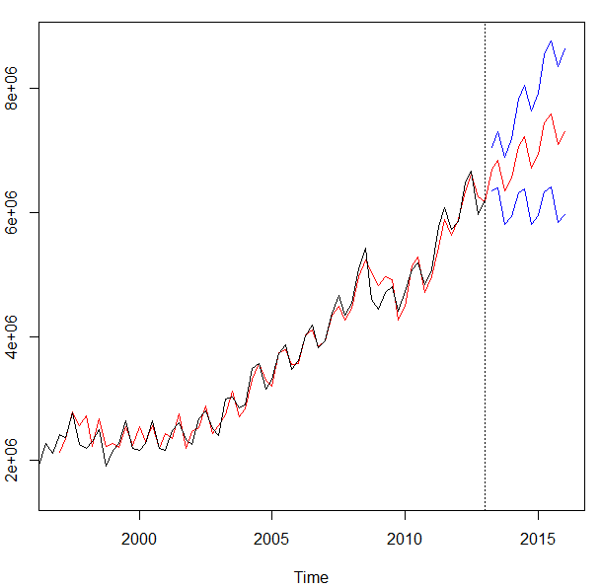
Growth Models are a form of time series forecasting
Model Based Methods
Holt Winters
Time Series Decomposition
Book Chapter 17
Regression Based Forecasting
Data Driven Methods
Forecasted value at period “n” is equal to some interactions of x-variable inputs

Slide 4
Model Based
Model Based approaches do not have x-variable inputs.
Use statistical, mathematical or other scientific model to approximate a data series.
Parameters of the model are learned in training then used to generate forecasts or more specifically the behavior of the phenomena.
Can be used with few data points
Remember how we only had the time series to get level, trend & seasonality?

Slide 5
When to use model vs data driven forecasting
Data Driven
Needs trustworthy historical data
Variables are engineered as inputs i.e. month dummy variables lagged x days as inputs
Apply a machine learning method like XGB
Data driven works when there is historical pattern, & data can be trusted. Model based approaches work when there is no/limited/lots of noise in the data.

Slide 6
When to use model vs data driven forecasting
Model Driven
Needs fewer data points
Lots of variability that is not easily quantifiable
Assumptions can be made for curve parameters
Data driven works when there is historical pattern, & data can be trusted. Model based approaches work when there is no/limited/lots of noise in the data.

Slide 7
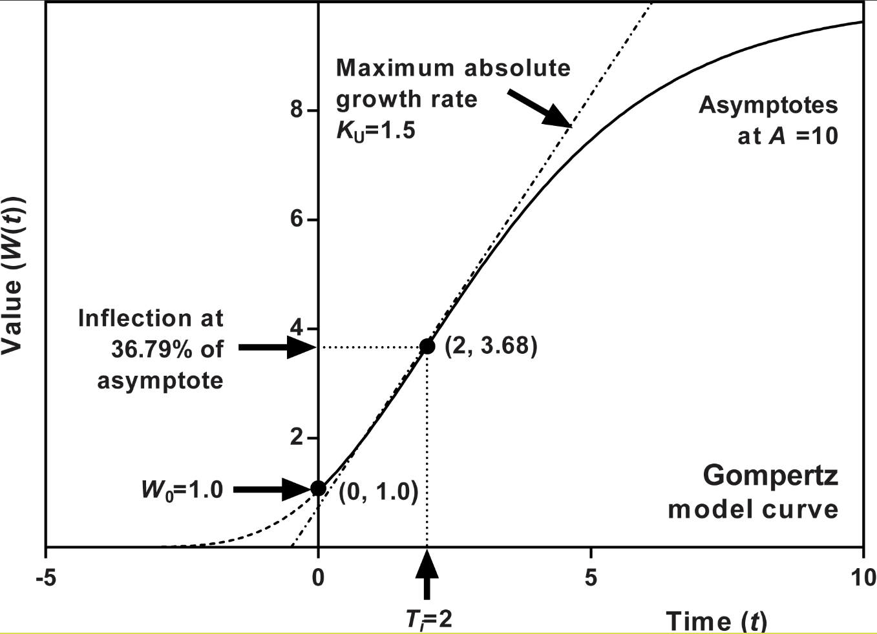
Gompertz Growth Curves
Gompertz Specifics
New Product Forecasting
Tumor Growth Modeling
Assumes the population doesn’t change (no natural birth/death rates)
Can help with planning on completely new item forecasting with only a few starting points & an upper limit to the population (market size potential)

Slide 8
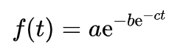
Gompertz Growth Curves
Double exponential
Where:
a = asymptote (a line that approaches a curve but does not meet it at any distance)
b = displacement on x-axis (how stretched out the curve is)
c = maximum growth rate (the slope of the curve)
e = 2.71828

Slide 9
Gompertz Growth Curves
Double exponential
Where:
a = asymptote
b = displacement on x-axis
c = growth rate
e = 2.71828
Biz:
a = total market potential at the last period
b = how long will it take for full market penetration
c = slope or adoption rate
e = 2.71828

Slide 10
Gompertz Growth Curves
Gompertz Specifics
Mkt potential
Biz:
a = 50

Slide 11
Gompertz Growth Curves
Gompertz Specifics
Biz:
a = 50
b = 5
Displacement

Slide 12
Gompertz Growth Curves
Max Slope
(max growth rate)
Biz:
a = 50
b = 5
c = 0.5 (rise / run)
Can be assumed & tested in product planning
Here, at most the biz will sell .5 widgets in a month
Just a simple example
e = 2.71828

Slide 13
Let’s practice
F_gompertzCurve.R

Slide 14
Agenda
Start | End | Item
 |  | Gompertz
 |  | Bass Models
 |  | SIR

Slide 15
SIR has 3 states of nature
Susceptible
People have no immunity.

Slide 16
SIR has 3 states of nature
Susceptible
Infected
At some rate, people become infected
For each infected person they may infect 1.2 people

Slide 17
SIR has 3 states of nature
Susceptible
Infected
Recovered
At some rate, people become recovered or removed.
The longer someone is infected the longer the rate of infection has a chance for more infections.

Slide 18
SIR has 3 states of nature
Susceptible
Infected
Recovered

Slide 19
SIR has 2 input parameters
Susceptible
beta
Infected
gamma
Recovered

Slide 20
SIR has 3 states of nature
Susceptible
beta
Infected
gamma
Recovered
Beta – rate of infection for the disease
Gamma – rate of recovery
R0 – beta/gamma = “contact rate”
Basic Reproduction Number (R0): the expected number of secondary infections generated by a single, typical infection in a completely susceptible population
https://web.stanford.edu/~jhj1/teachingdocs/Jones-Epidemics050308.pdf
https://web.stanford.edu/~jhj1/teachingdocs/Jones-on-R0.pdf

Slide 21
SIR Assumptions
Susceptible
Infected
Recovered
No one joins the susceptible group, since we are ignoring births and immigration
No on is re-infected (next slide)
Everyone in population has the same probability of infection (for example does not account for elderly, first responders or frontline workers)
Population is homogeneous (for example no social circles for immigrant or affluent communities…all the same

Slide 22
SIR Assumptions
Susceptible
Infected
Recovered
Other Similar Models:
No/Limited Immunity
SIRS (Susceptible - Infectious - Recovered - Susceptible)
Not necessarily infected once exposed
SEIR (Susceptible – Exposed – Infectious – Recovered)

Slide 23
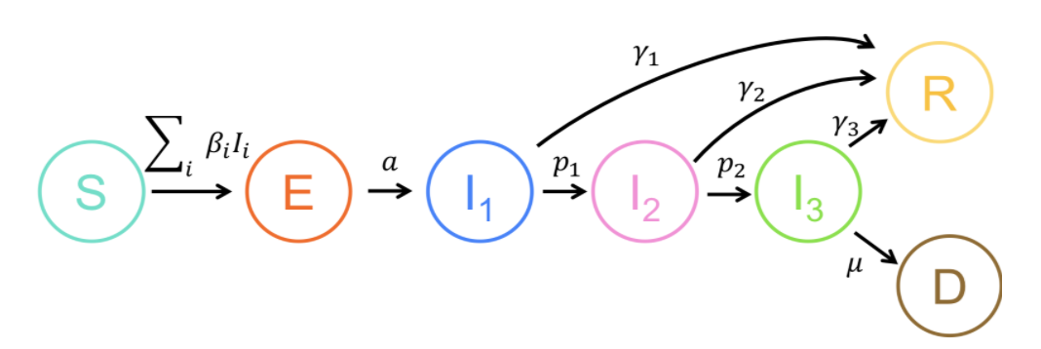
There can be more states of nature
Susceptible
Exposed
Infected – not hospitalized
Infected – hospitalized
Infected – ICU
Recovered
Dead

Slide 24
We will build the SIR model w/beta, gamma & total population
Susceptible
beta
Infected
gamma
Recovered
Beta – rate of infection for the disease
Gamma – rate of recovery/removal

Slide 25
Let’s Practice
G_SIR.R
Haha, misspelled
quarantine!

Slide 26


Thank you.
Ring….Ring…Ring…”Dale the semester is basically over”
Every student in CSCI-96

